Slide 1
Few-Shot Unsupervised Image-to-Image Translation
By E Pannell

Slide 2
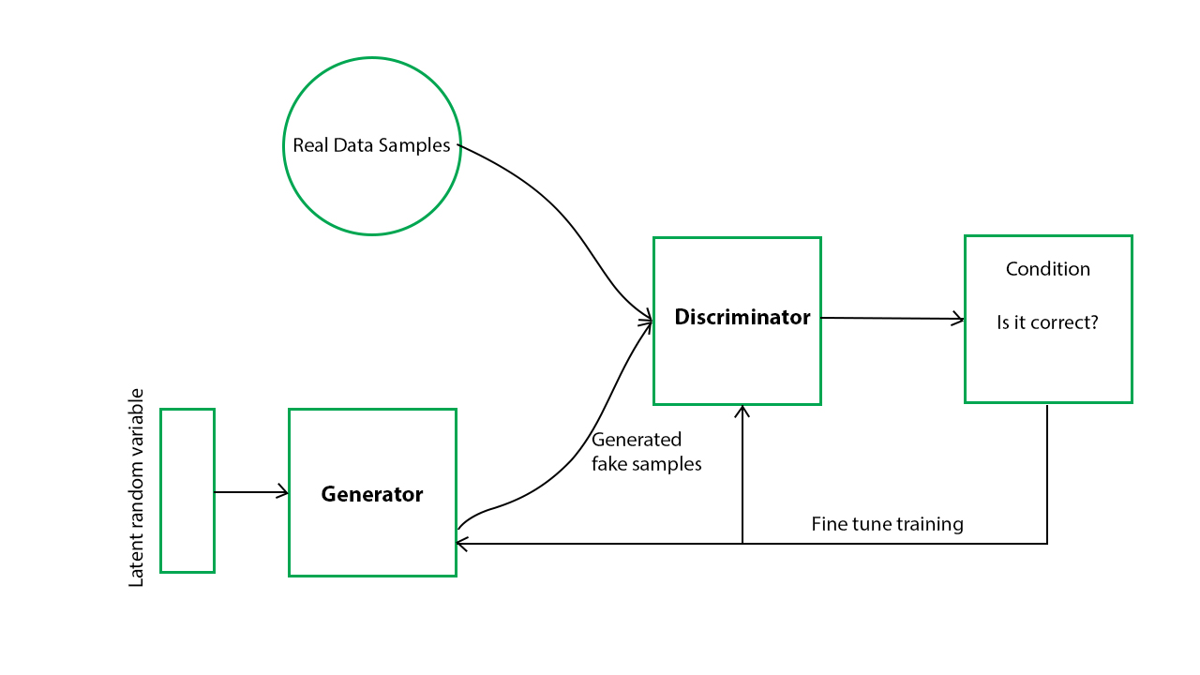
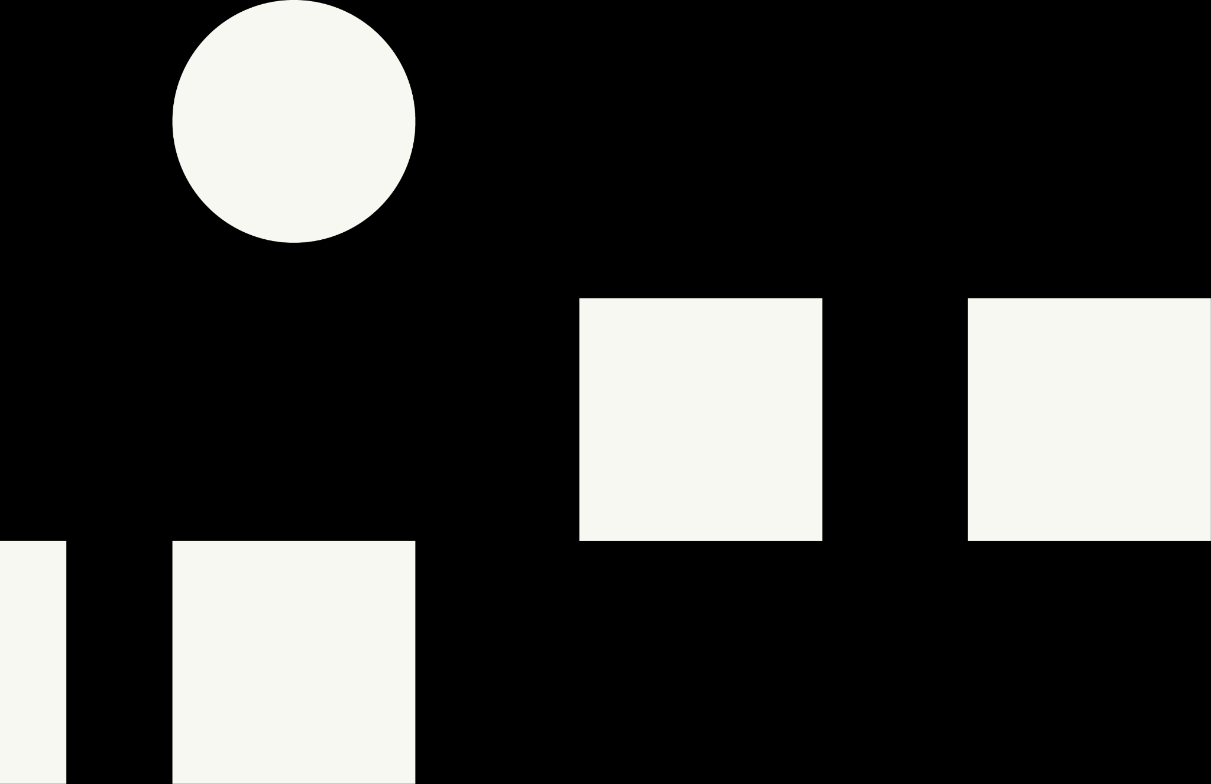
GAN
Generative:
To learn a generative model, which describes how data is generated in terms of a probabilistic model.
Adversarial:
The training of a model is done in an adversarial setting.
Networks:
Use deep neural networks as the artificial intelligence (AI) algorithms for training purpose.
However, needs a huge amount of training data.
Real Data Samples
Generated fake examples
Discriminator
Condition
Latent Random Variable
Generator
Fine tune training
Source: https://www.geeksforgeeks.org/generative-adversarial-network-gan/
Notes:
Can be used for a multitude of things

Slide 3
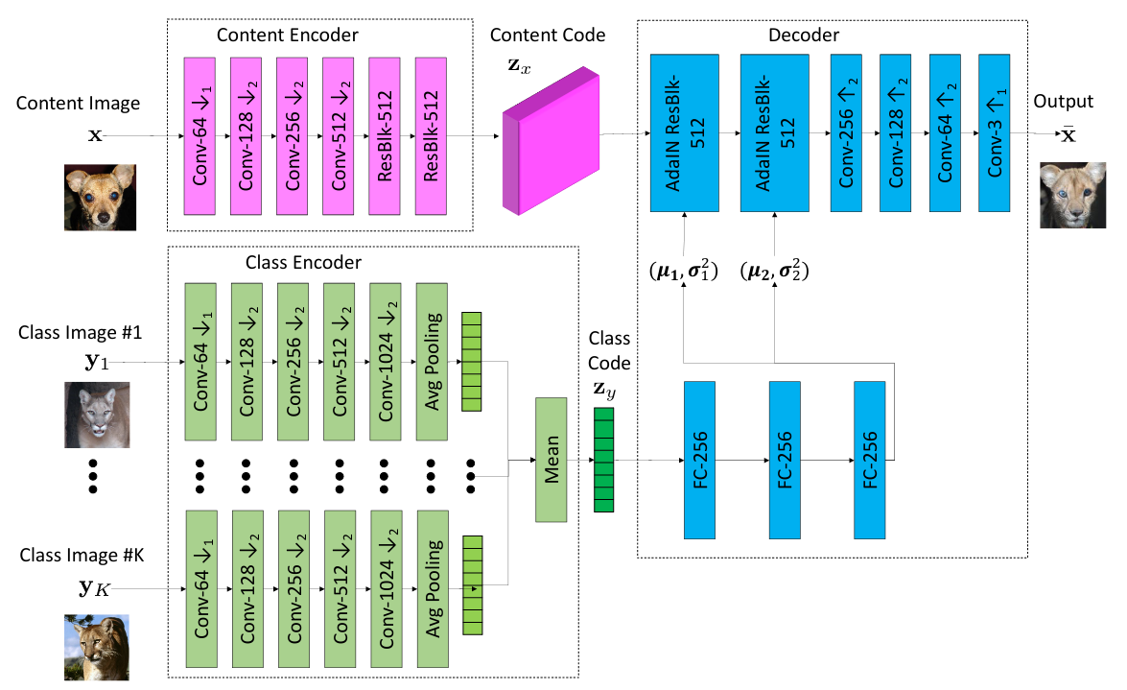
FUNIT
[F]ew-Shot
[UN]supervised
[I]mage-to-Image
[T]ranslation
Notes:
The name of the paper, concise

Slide 4
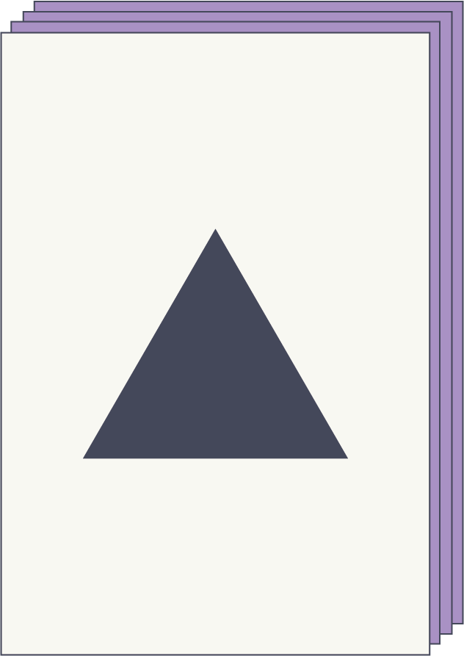
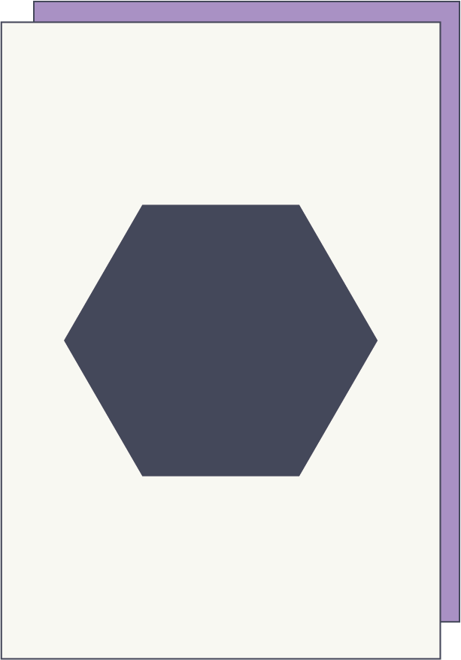
Few-Shot
Known as Few-Shot Learning.
This describes the use of training a model with minimal amount of data.
Source - https://www.unite.ai/few-shot-learning/
Standard
Few-Shot

Slide 5
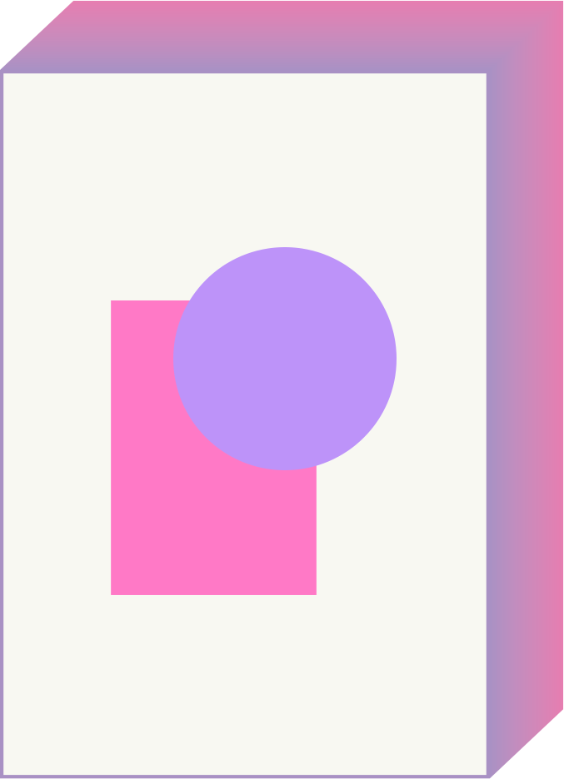
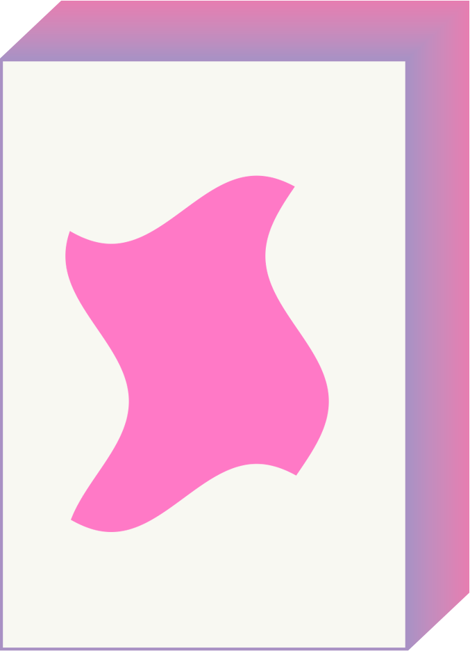
Unsupervised
Unsupervised learning.
Where the training data has no labels.

Slide 6
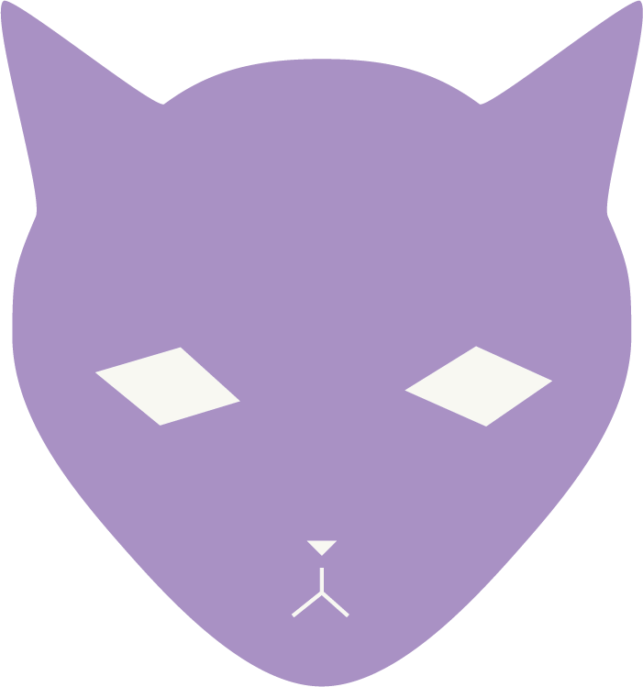

Image-to-image translation
Converts an image into another of the same context with a different style.

Slide 7
FUNIT
[F]ew-Shot
[UN]supervised
[I]mage-to-Image
[T]ranslation
Notes:
The name of the paper, concise

Slide 12
FUNIT Examples
Using the papers demo page: http://nvidia-research-mingyuliu.com/ganimal/

Slide 13
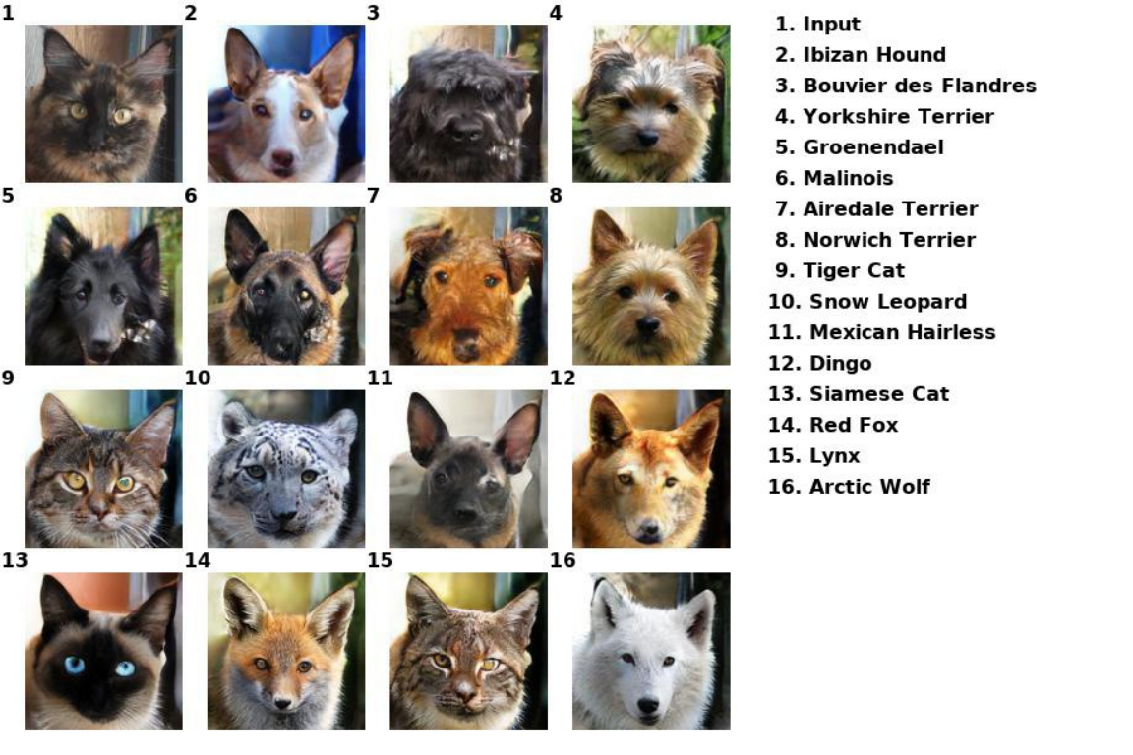
Notes:
Conventional angle, most are looking good

Slide 14
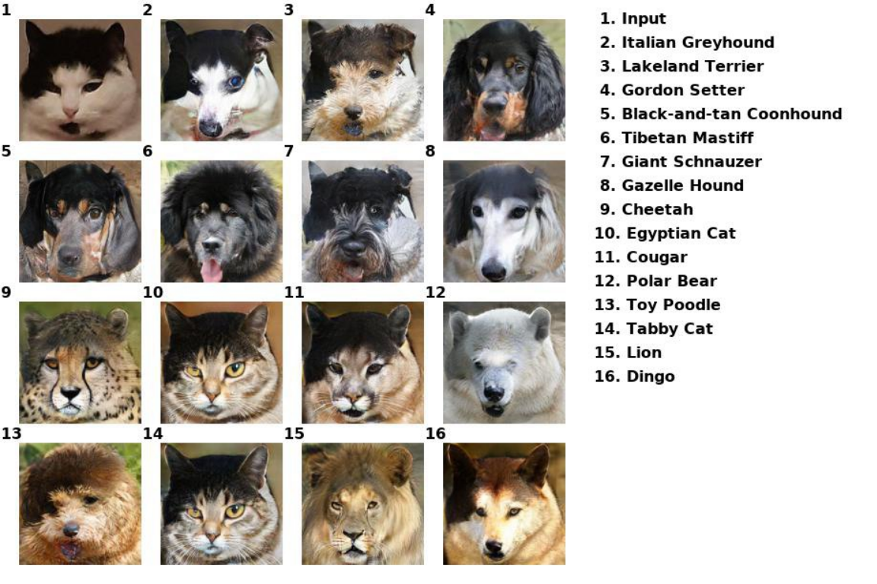
Notes:
Fairly conventional, but colours messed around with result

Slide 15
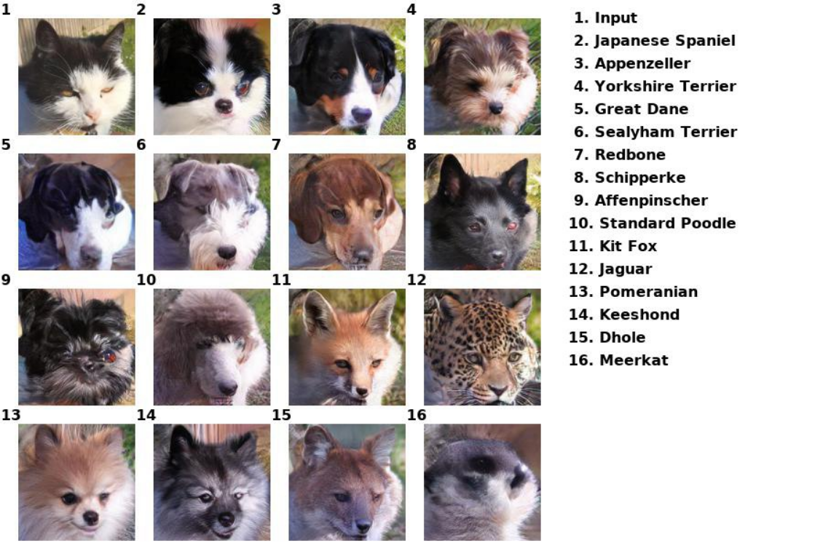
Notes:
Unconventional angle

Slide 16
Bibliography
GANs - https://www.geeksforgeeks.org/generative-adversarial-network-gan/
Few-Shot Unsupervised Image-to-Image Translation - https://arxiv.org/abs/1905.01723
Few-Shot Learning - https://www.unite.ai/few-shot-learning/
Demo - http://nvidia-research-mingyuliu.com/ganimal/

